Slide 1
CAPSTONE
The Capstone project is a requirement for successfully completing the Data Analytics course at Francis Tuttle Technology Center.

Slide 2
Project Title
State Good to Live in 2024

Slide 3
The goal of this project is to identify the best state to live in, primarily based on 2023 data, tailored to individual preferences. To determine the most comfortable and convenient place to live, the data has been categorized into nine key sections:
Climate
Cost of Living
Crime
Education
Environment
Healthcare
Job Market
Politics
Taxes

Slide 4
Technologies used in project
Excel
Python
SQL Server
Power BI
Excel is used to accumulate the data in tables and for preliminary tables structure.
Python is used for scrapping the table-based data from websites without download options.
MS SQL Server is used to store, manage, and retrieve data as requested by other software applications.
Power BI is used to transform raw data into meaningful insights and create interactive reports and visualizations.

Slide 5
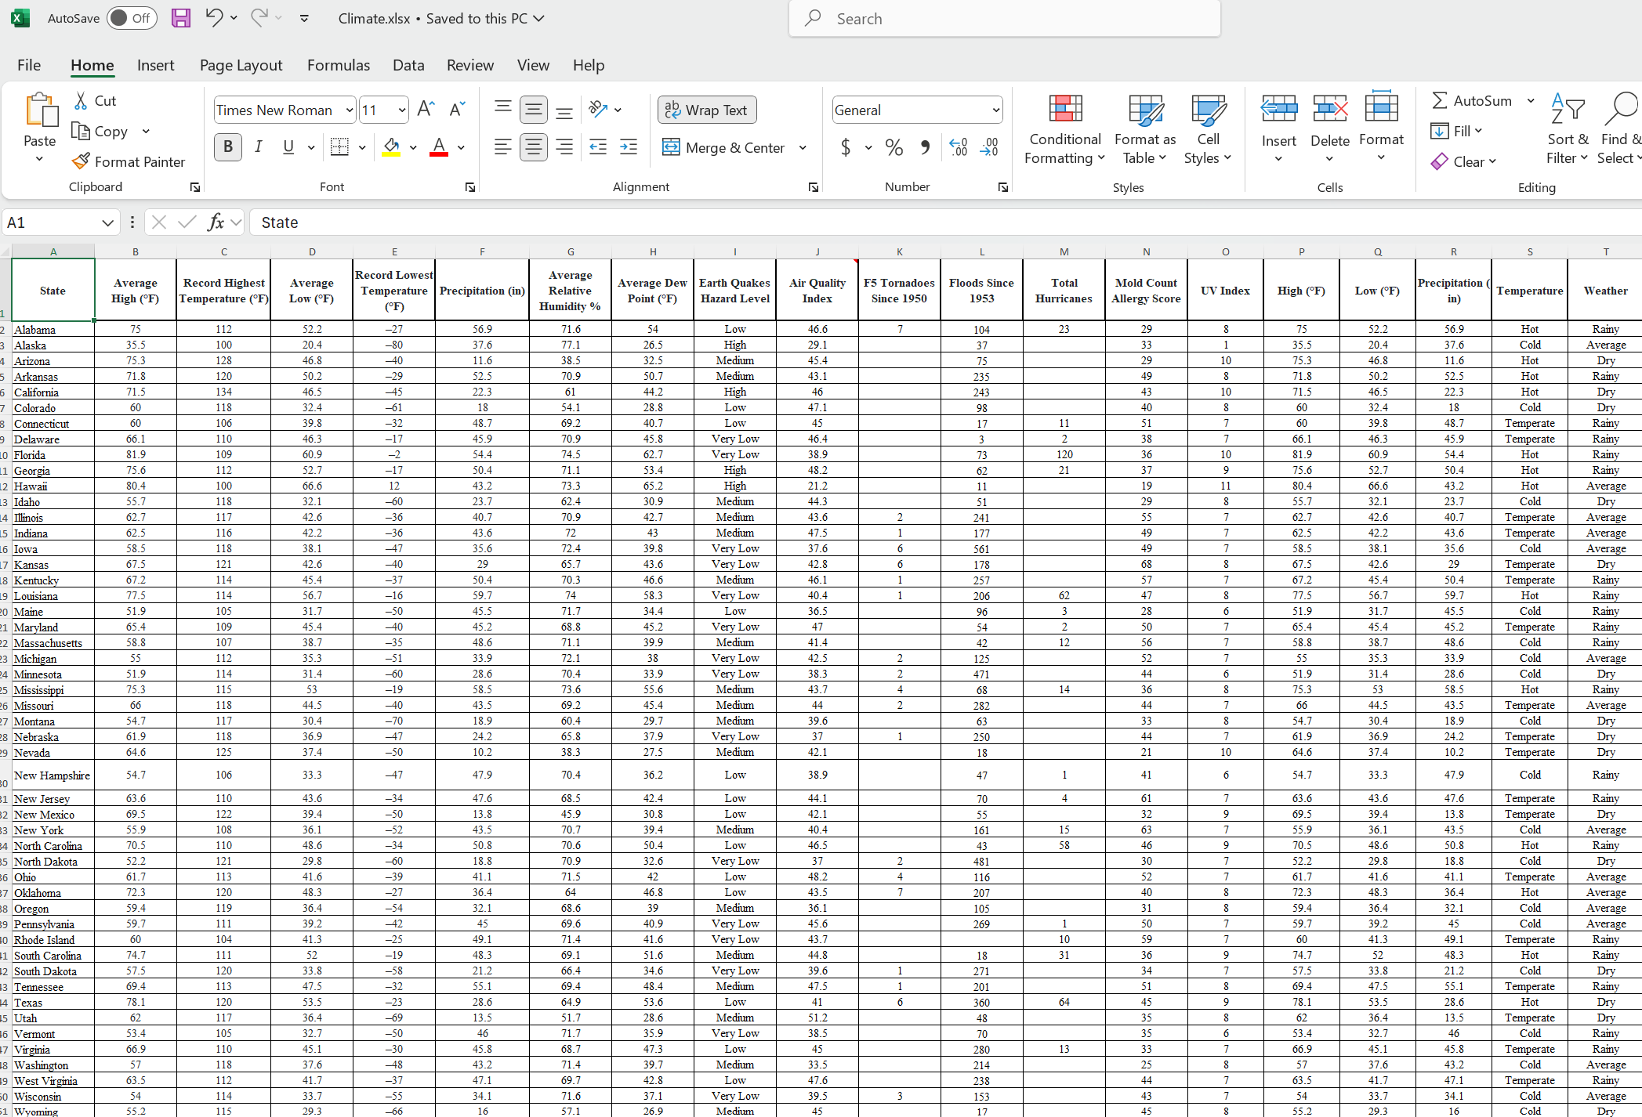
Excel Climate

Slide 6
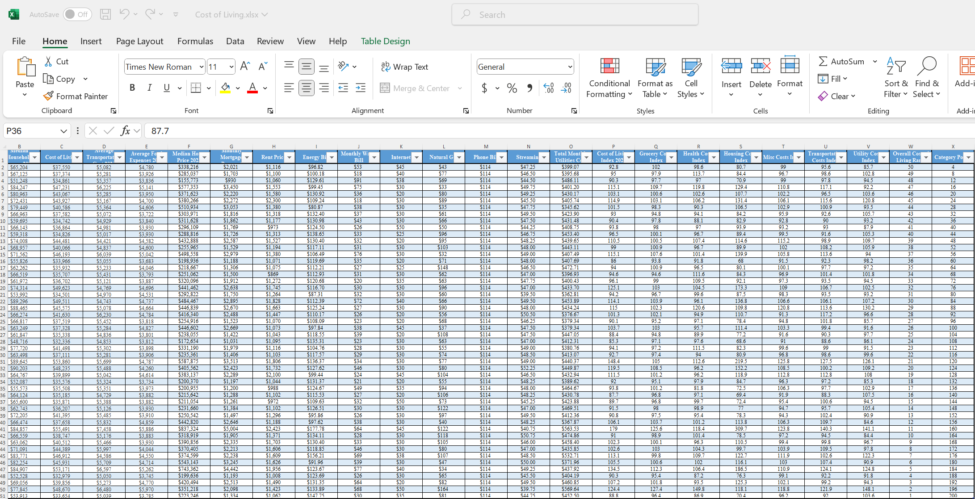
Excel Coast of Living

Slide 7
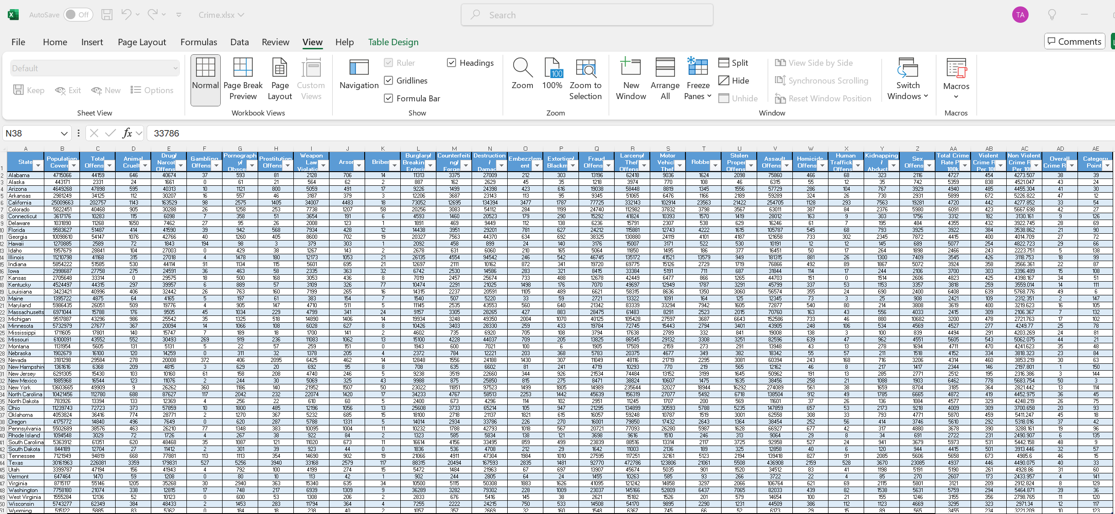
Excel Crime

Slide 8
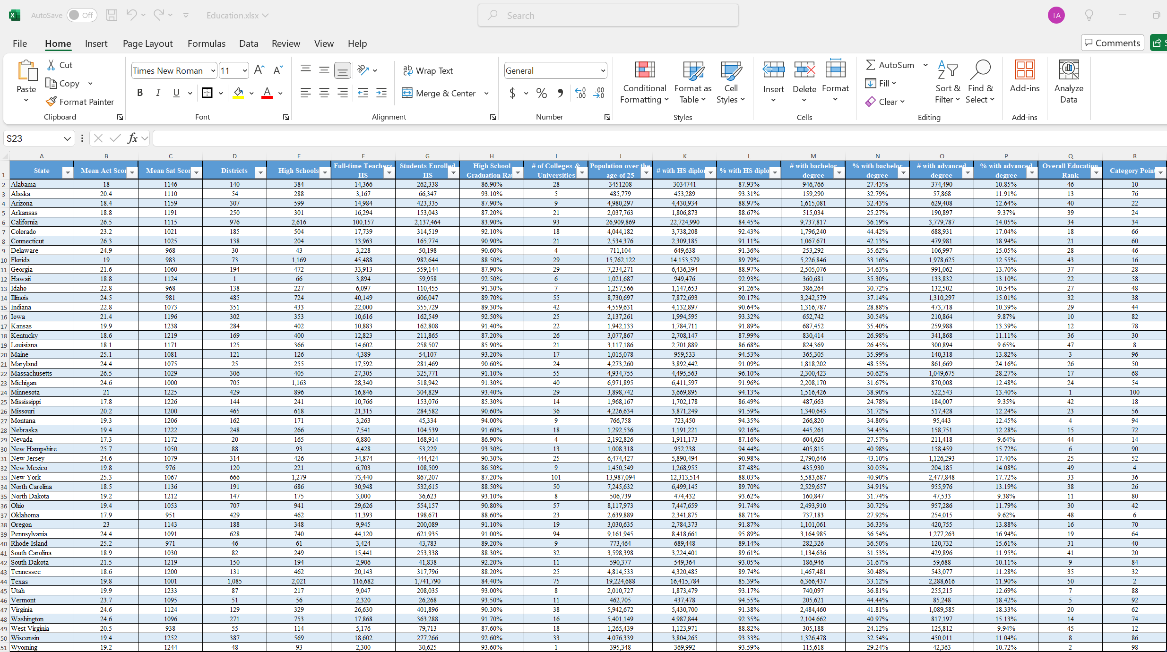
Excel Education

Slide 9
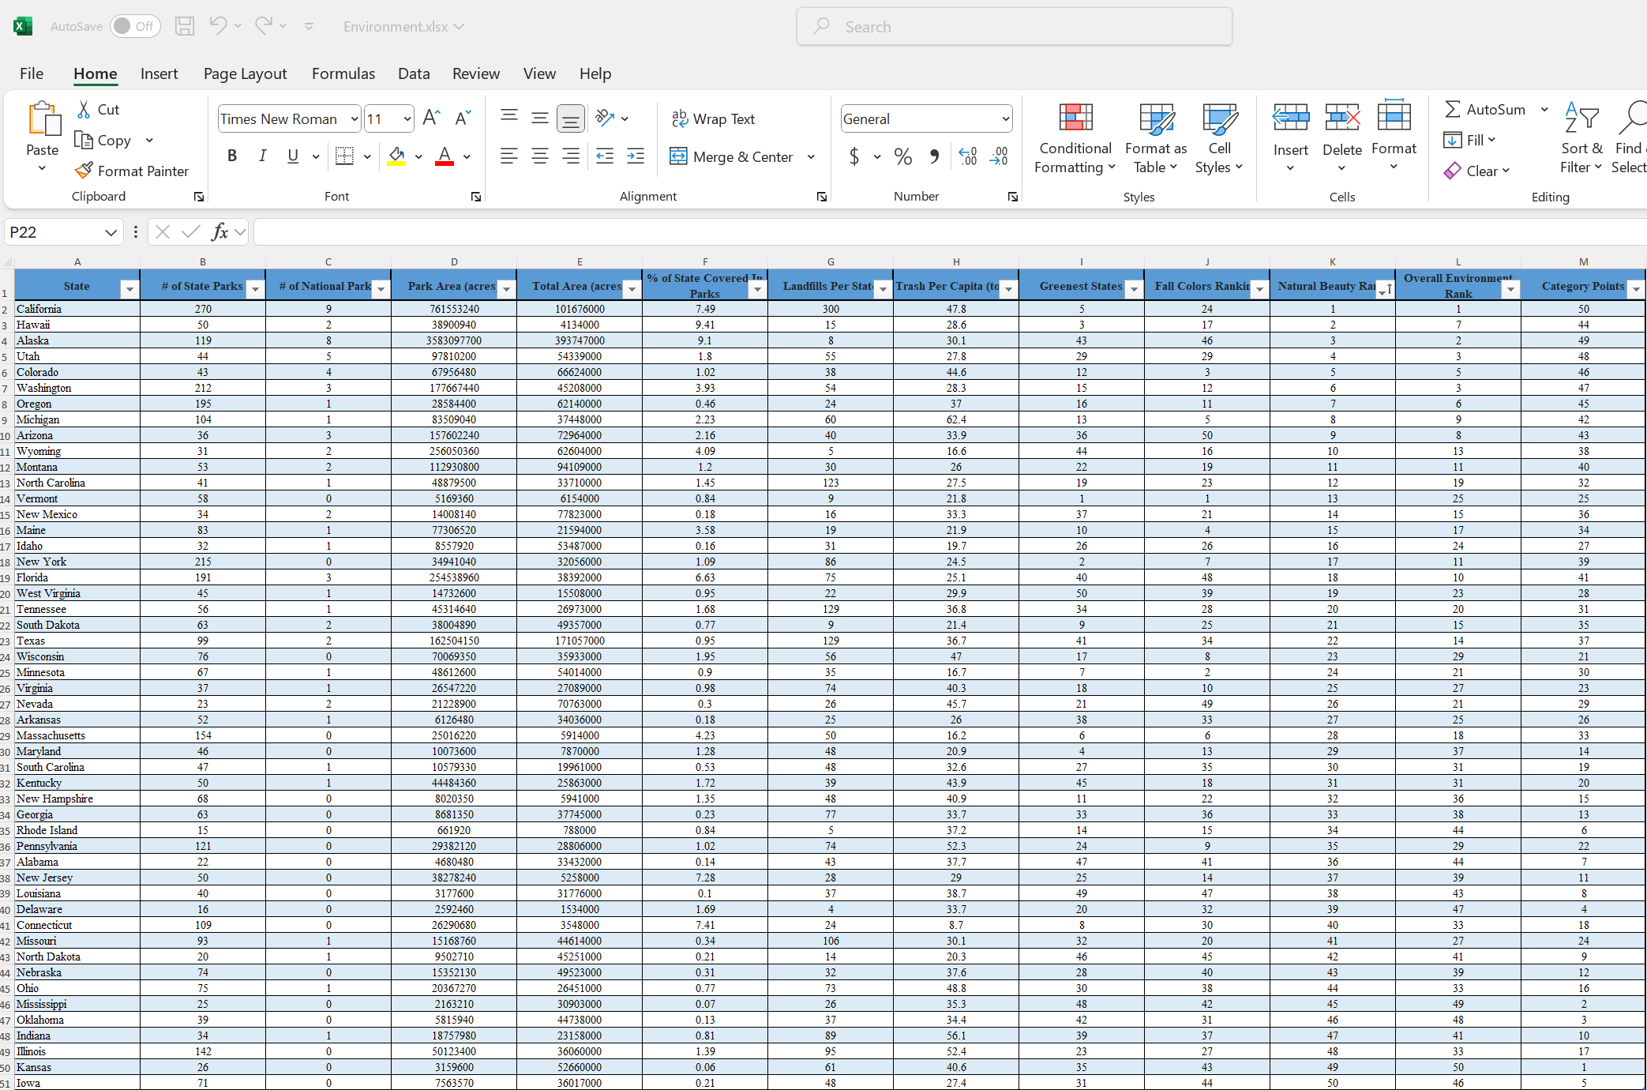
Excel Environment

Slide 10
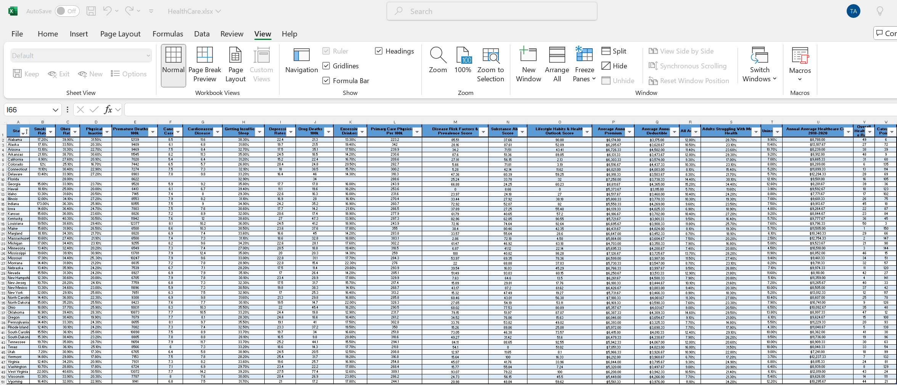
Excel Healthcare

Slide 11
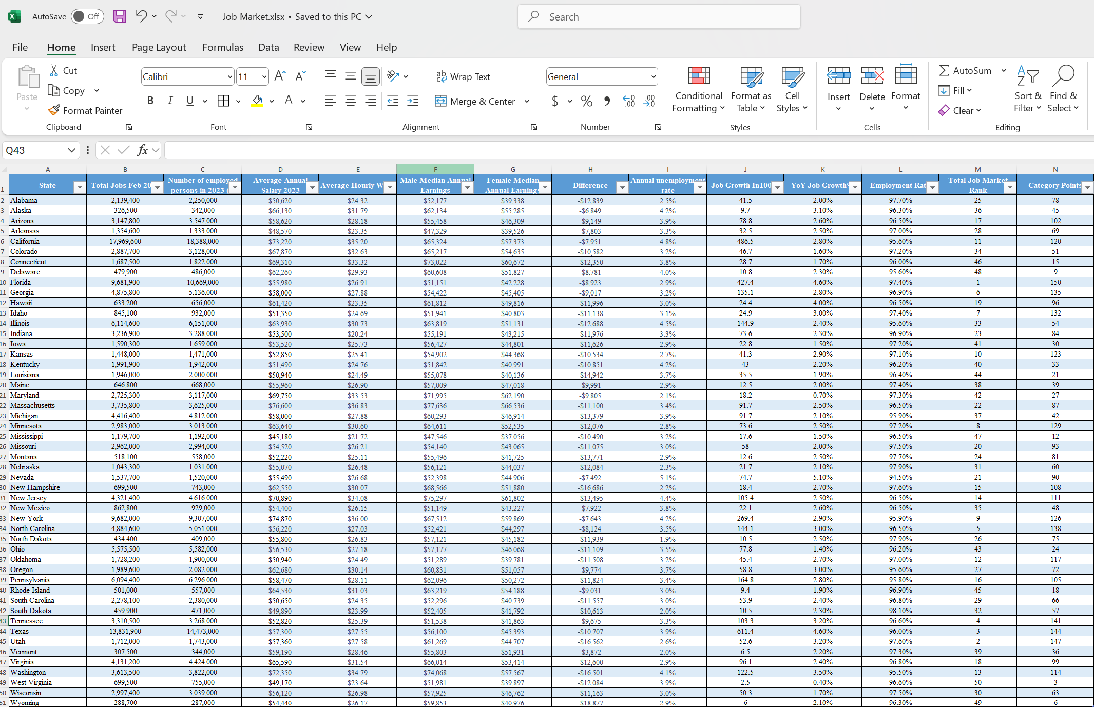
Excel Job Market

Slide 12
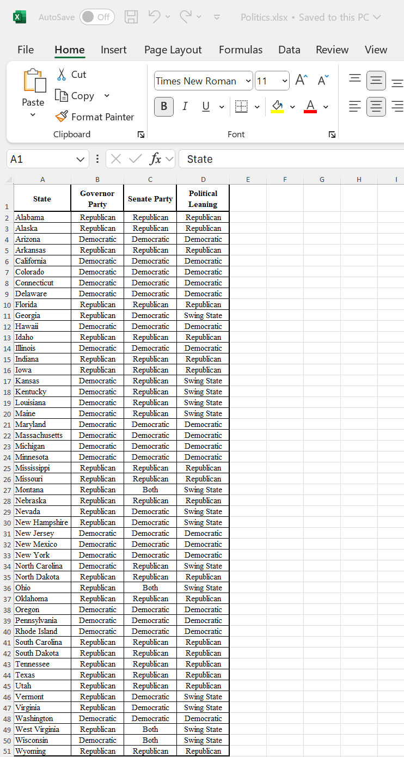
Excel Politics

Slide 13
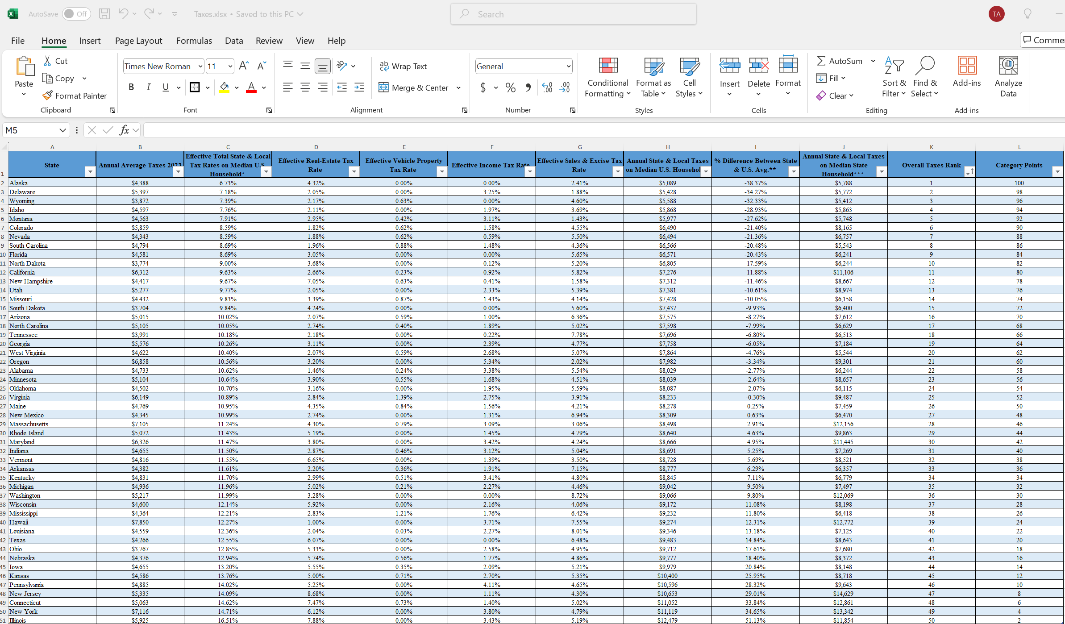
Excel Taxes

Slide 14
Python
To scrape data from websites, I used the Python library BeautifulSoup.
To load and manipulate the data in CSV format, I utilized the Pandas library in Python.

Slide 15
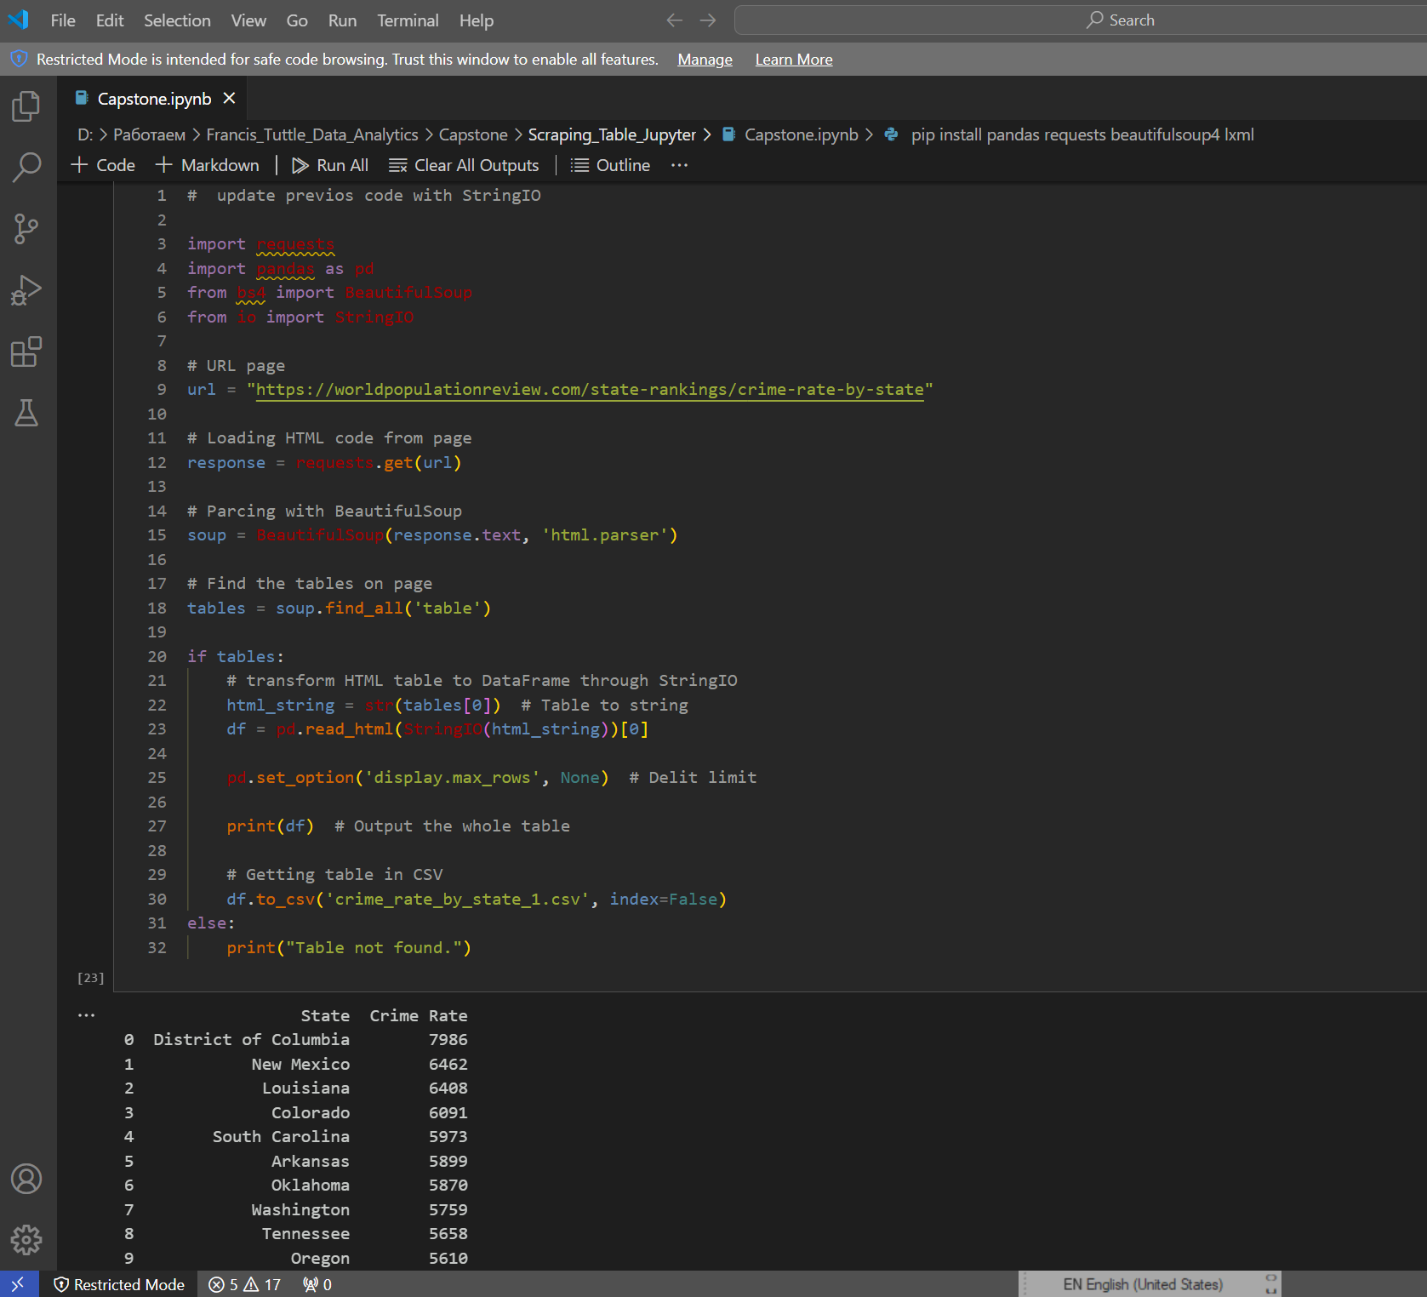
Code to find firs table on the webpage https://worldpopulationreview.com/state-rankings/crime-rate-by-state

Slide 16
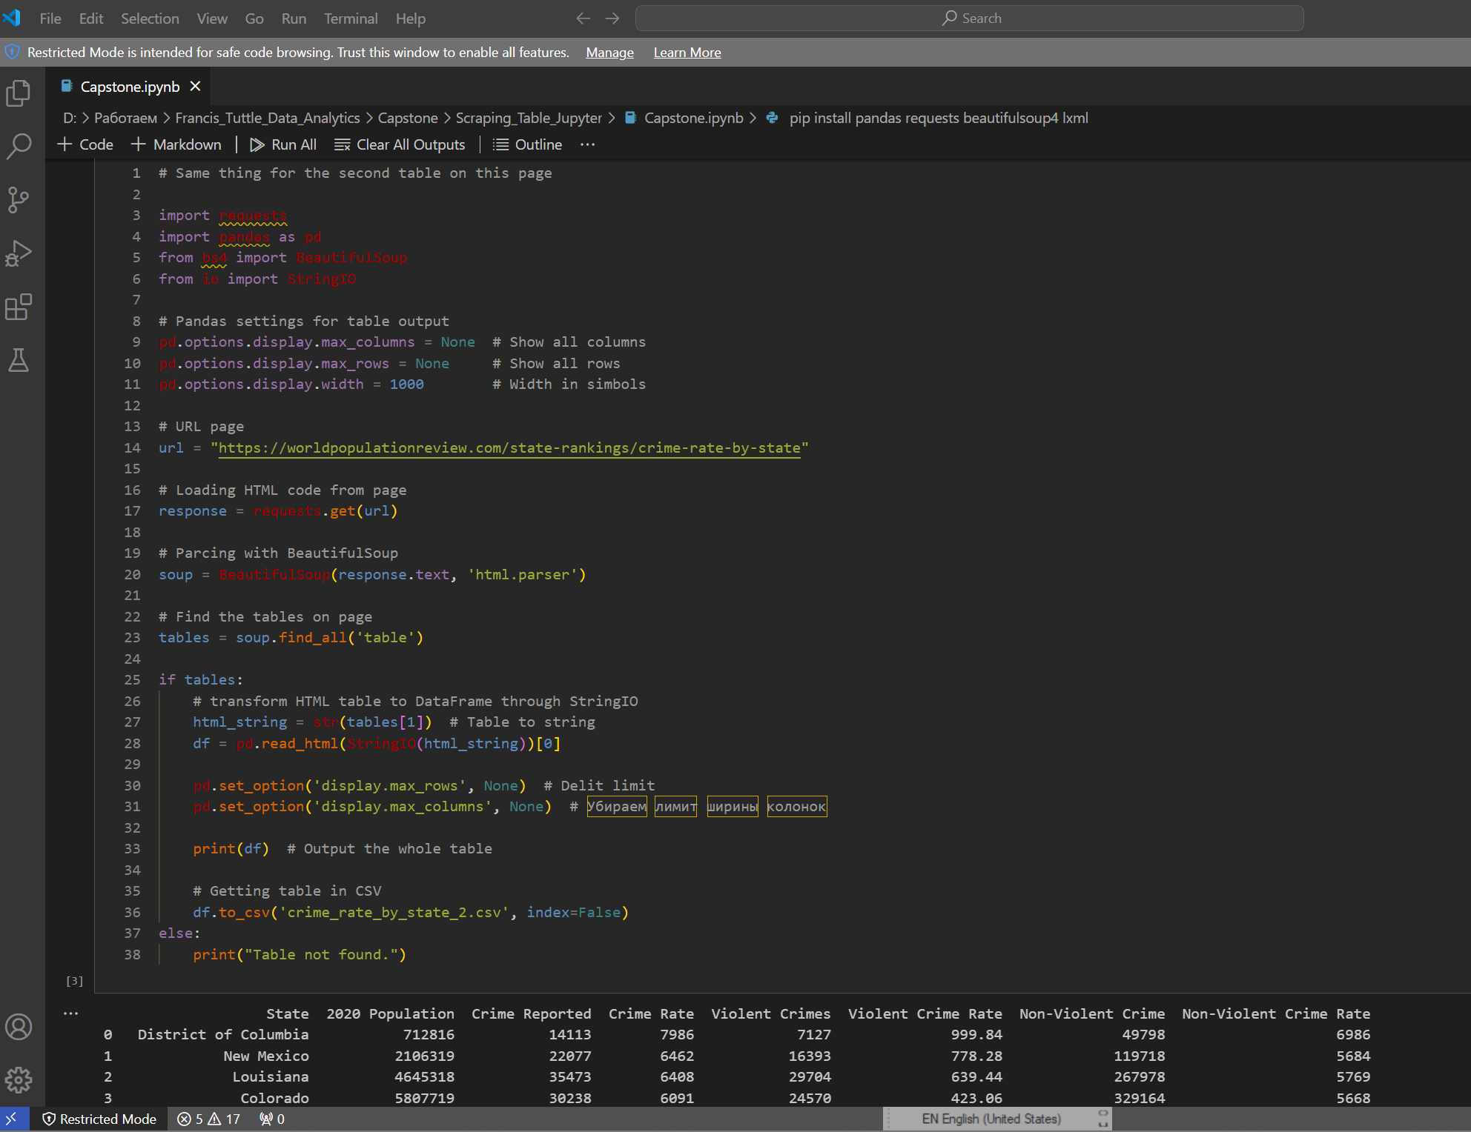
Code to find second table https://worldpopulationreview.com/state-rankings/crime-rate-by-state

Slide 17
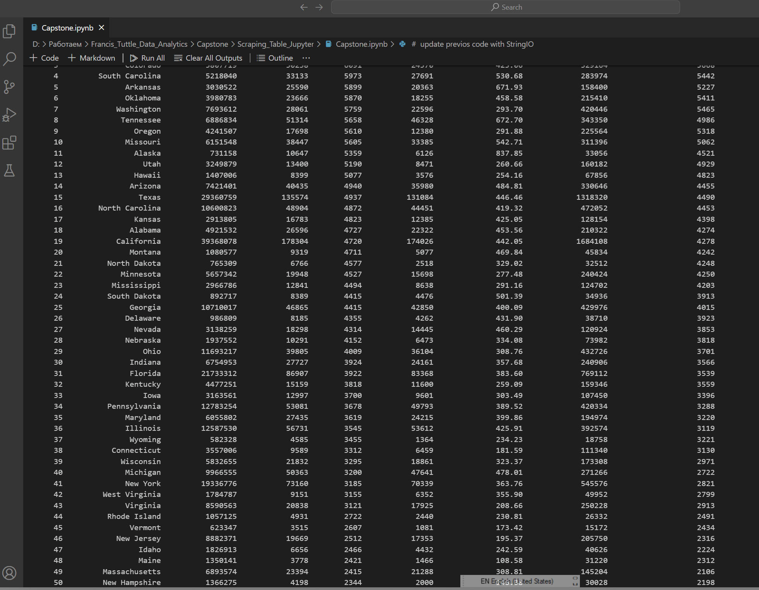
Result for second table

Slide 18
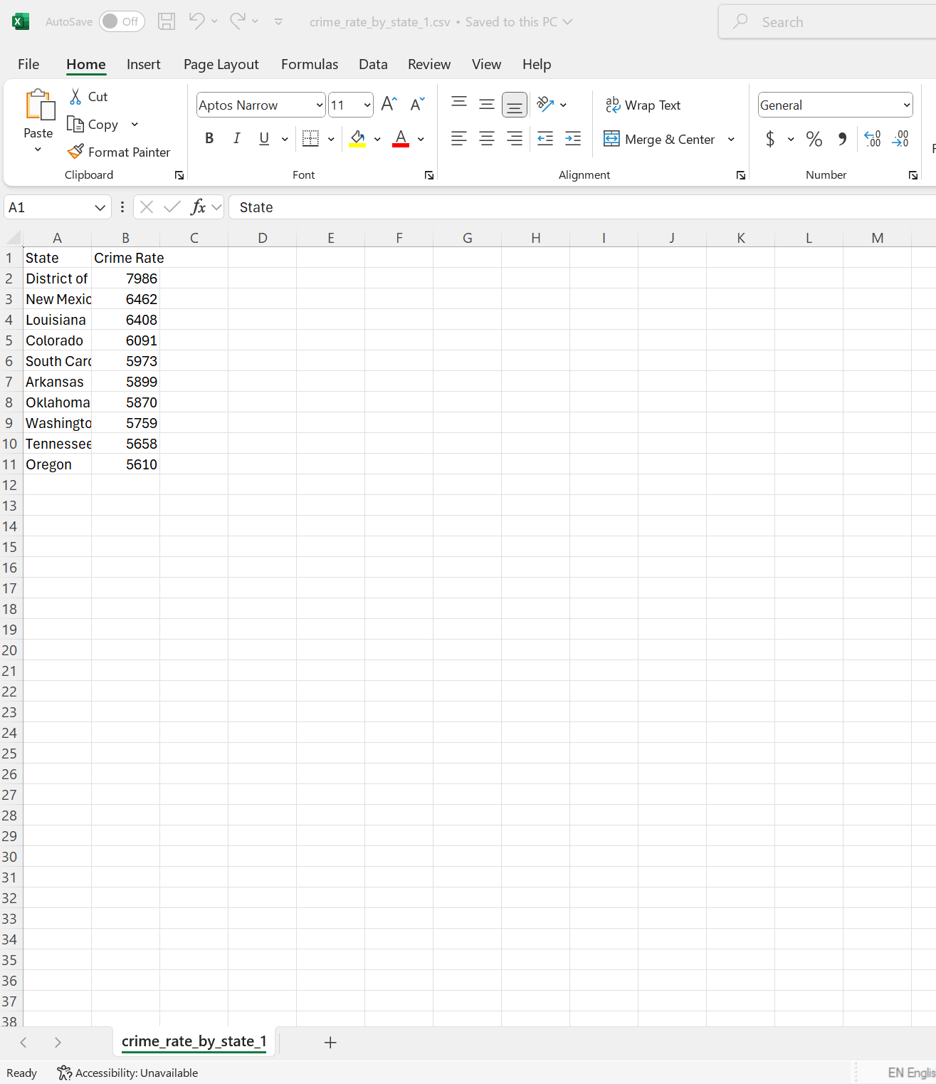
Saved tables in CSV files

Slide 19
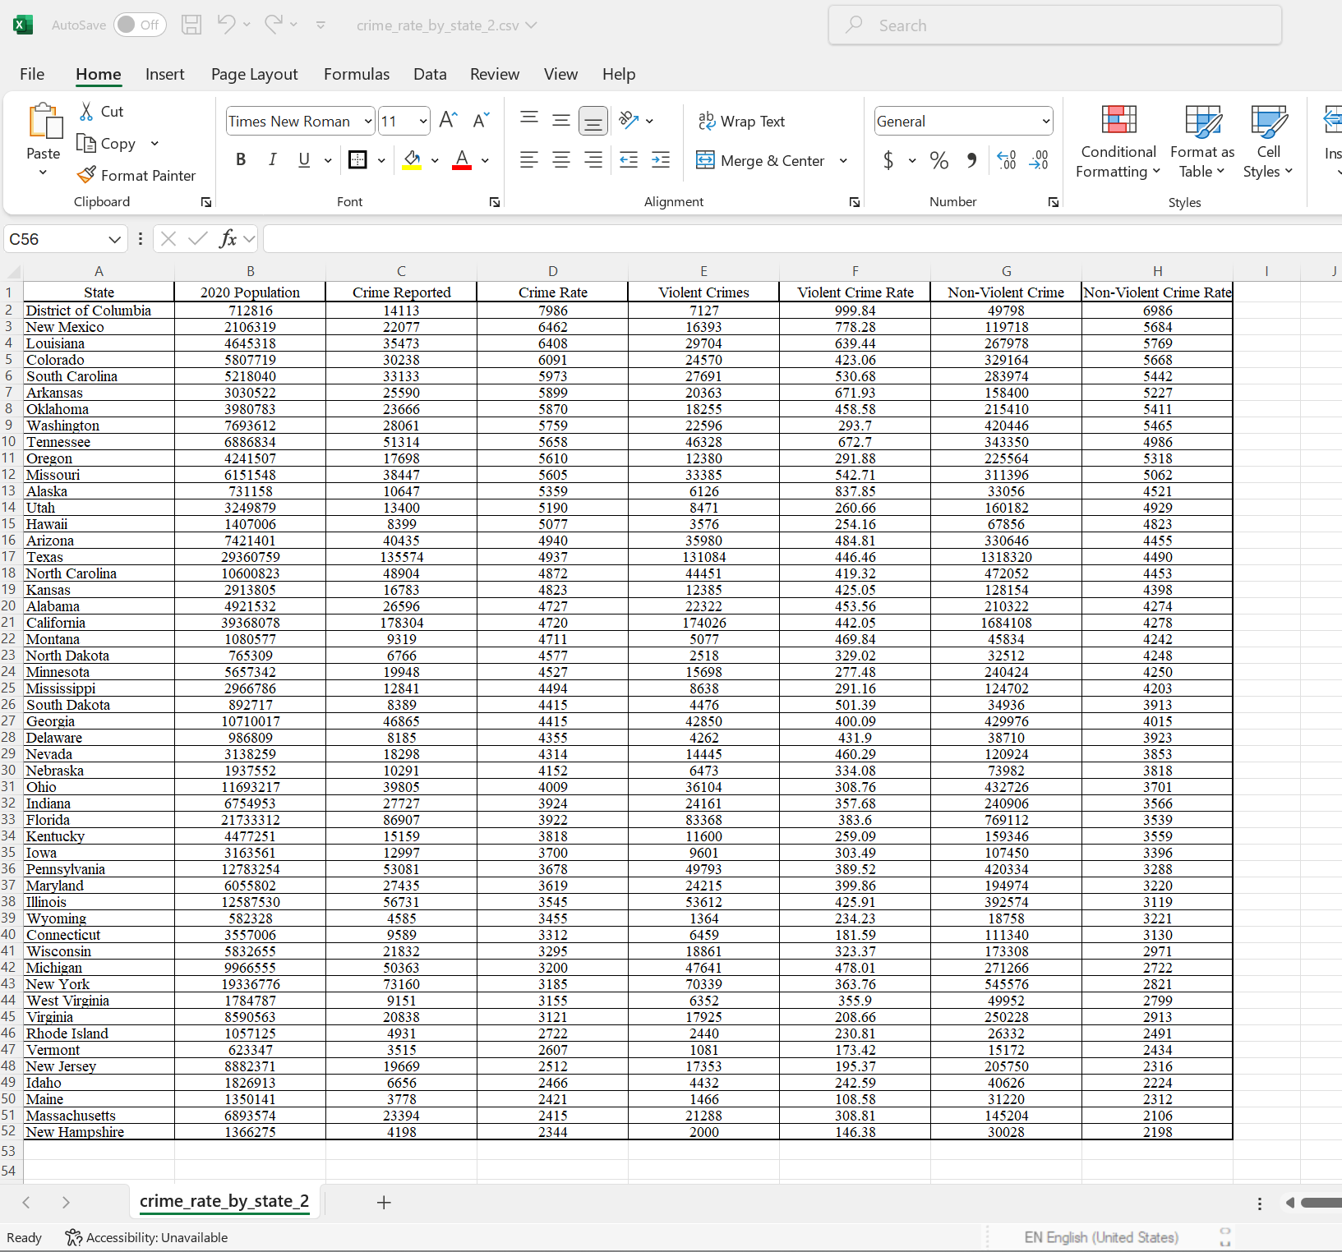
Saved tables in CSV files

Slide 20
MS SQL Server
The data was exported from MS Excel spreadsheets into SQL Server.
Using SQL queries, I modified the data types as needed.
Once all nine tables were updated, I used SQL joins to create a final table that includes selected columns from each of the original tables.

Slide 21
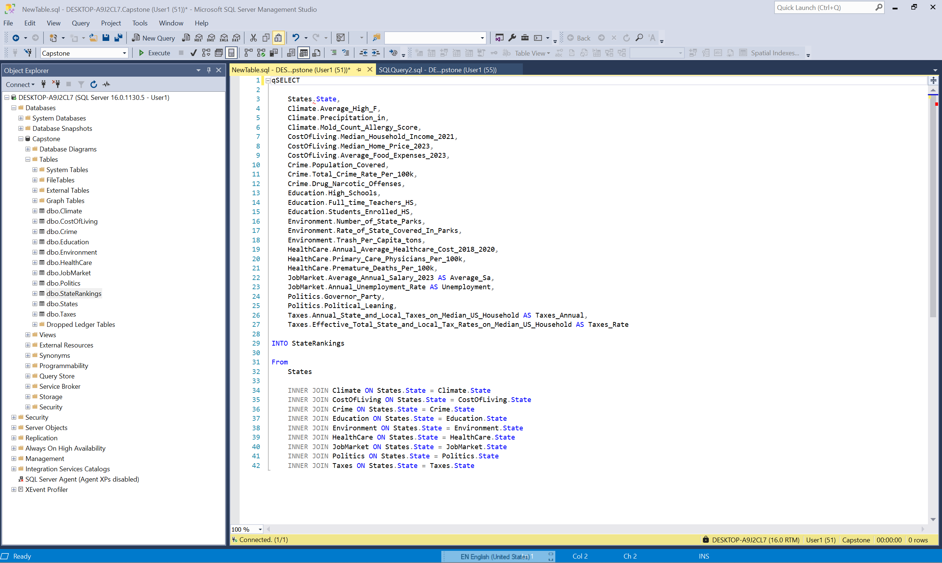
Query to join final table

Slide 22
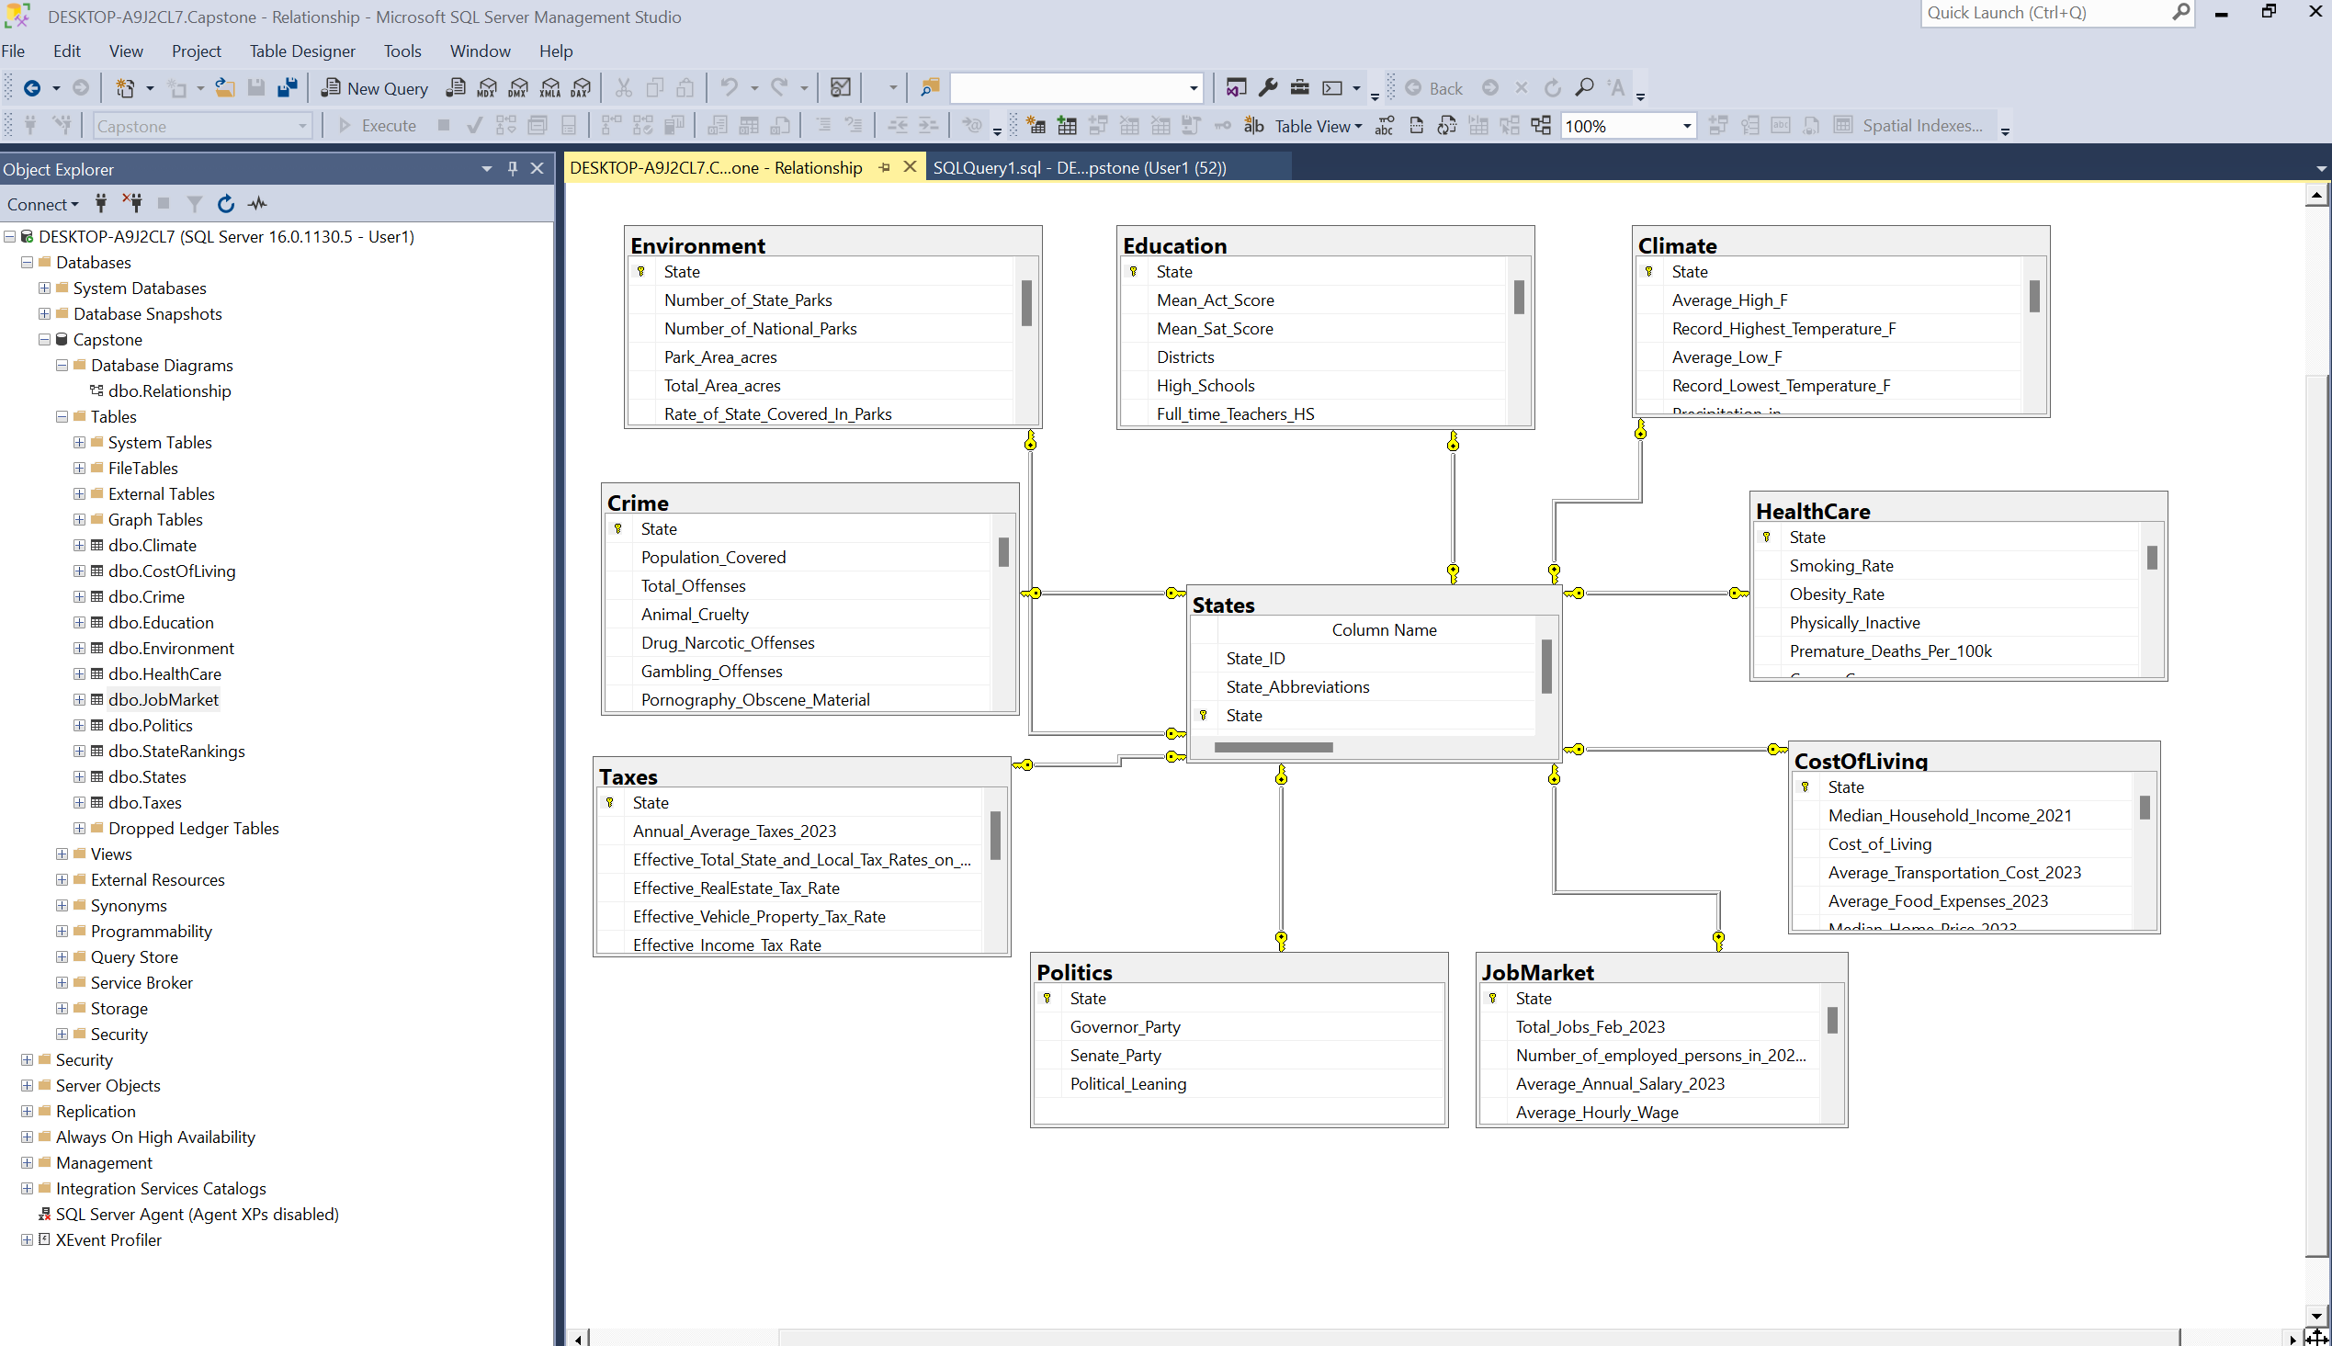
Primary Key

Slide 23
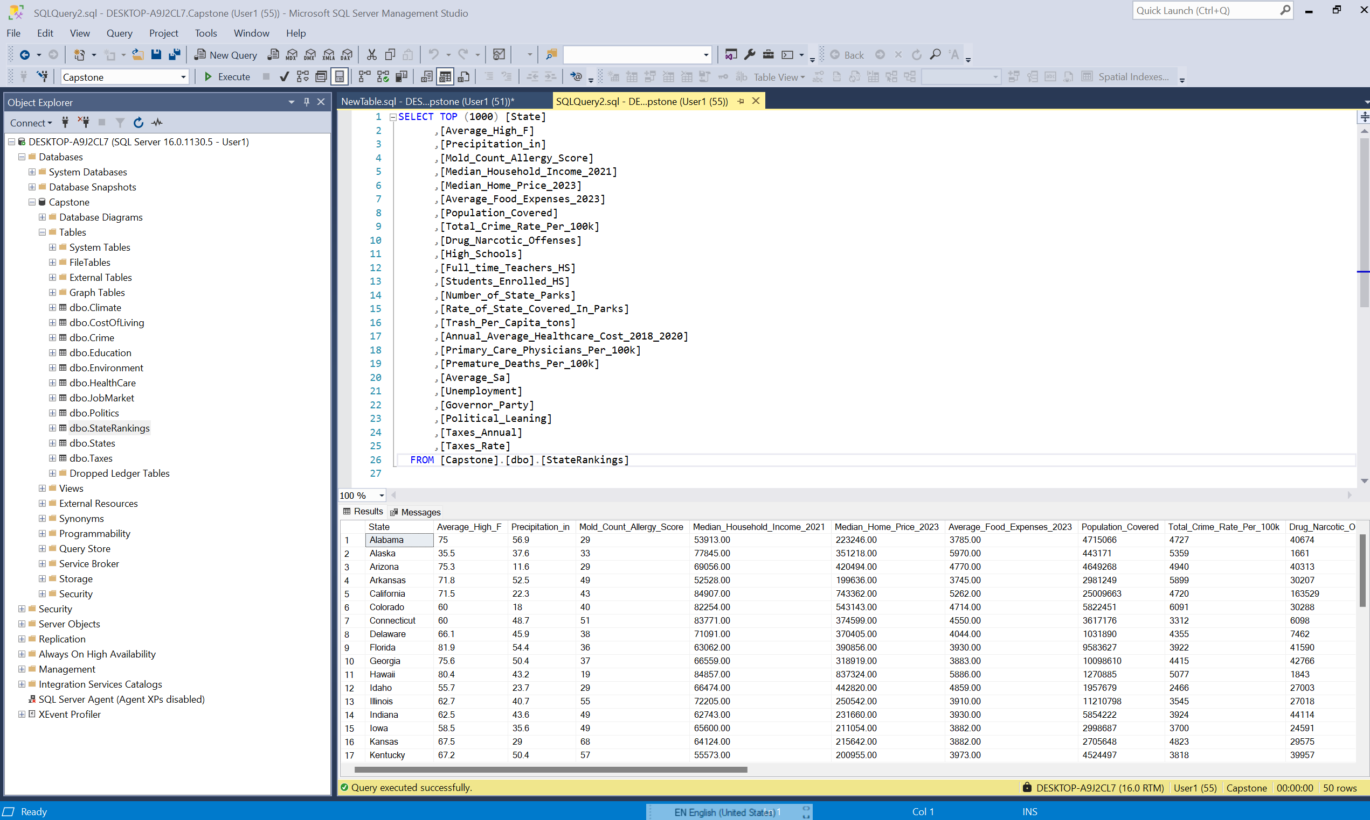
Select all for final table

Slide 24
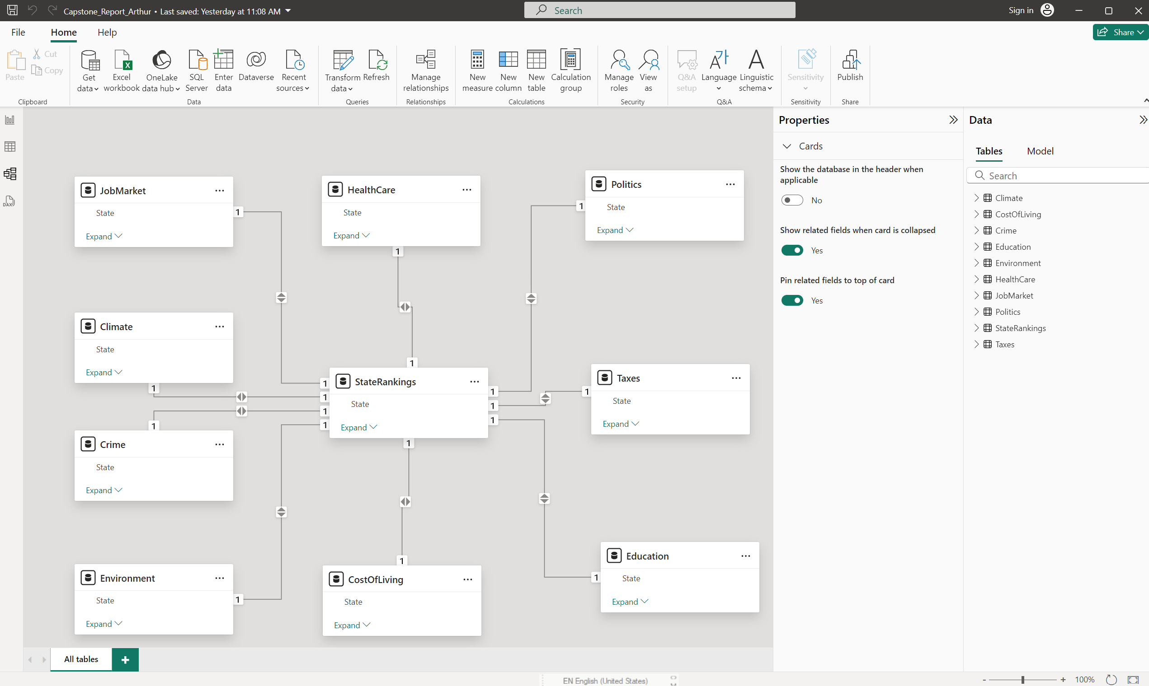
Power BI Relationship

Slide 25
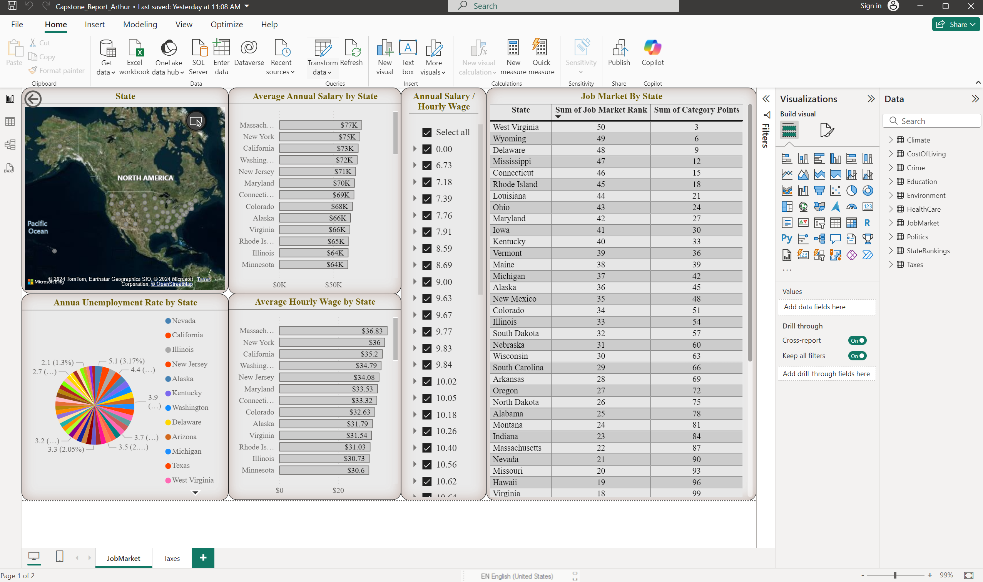
Power BI Job Market

Slide 26
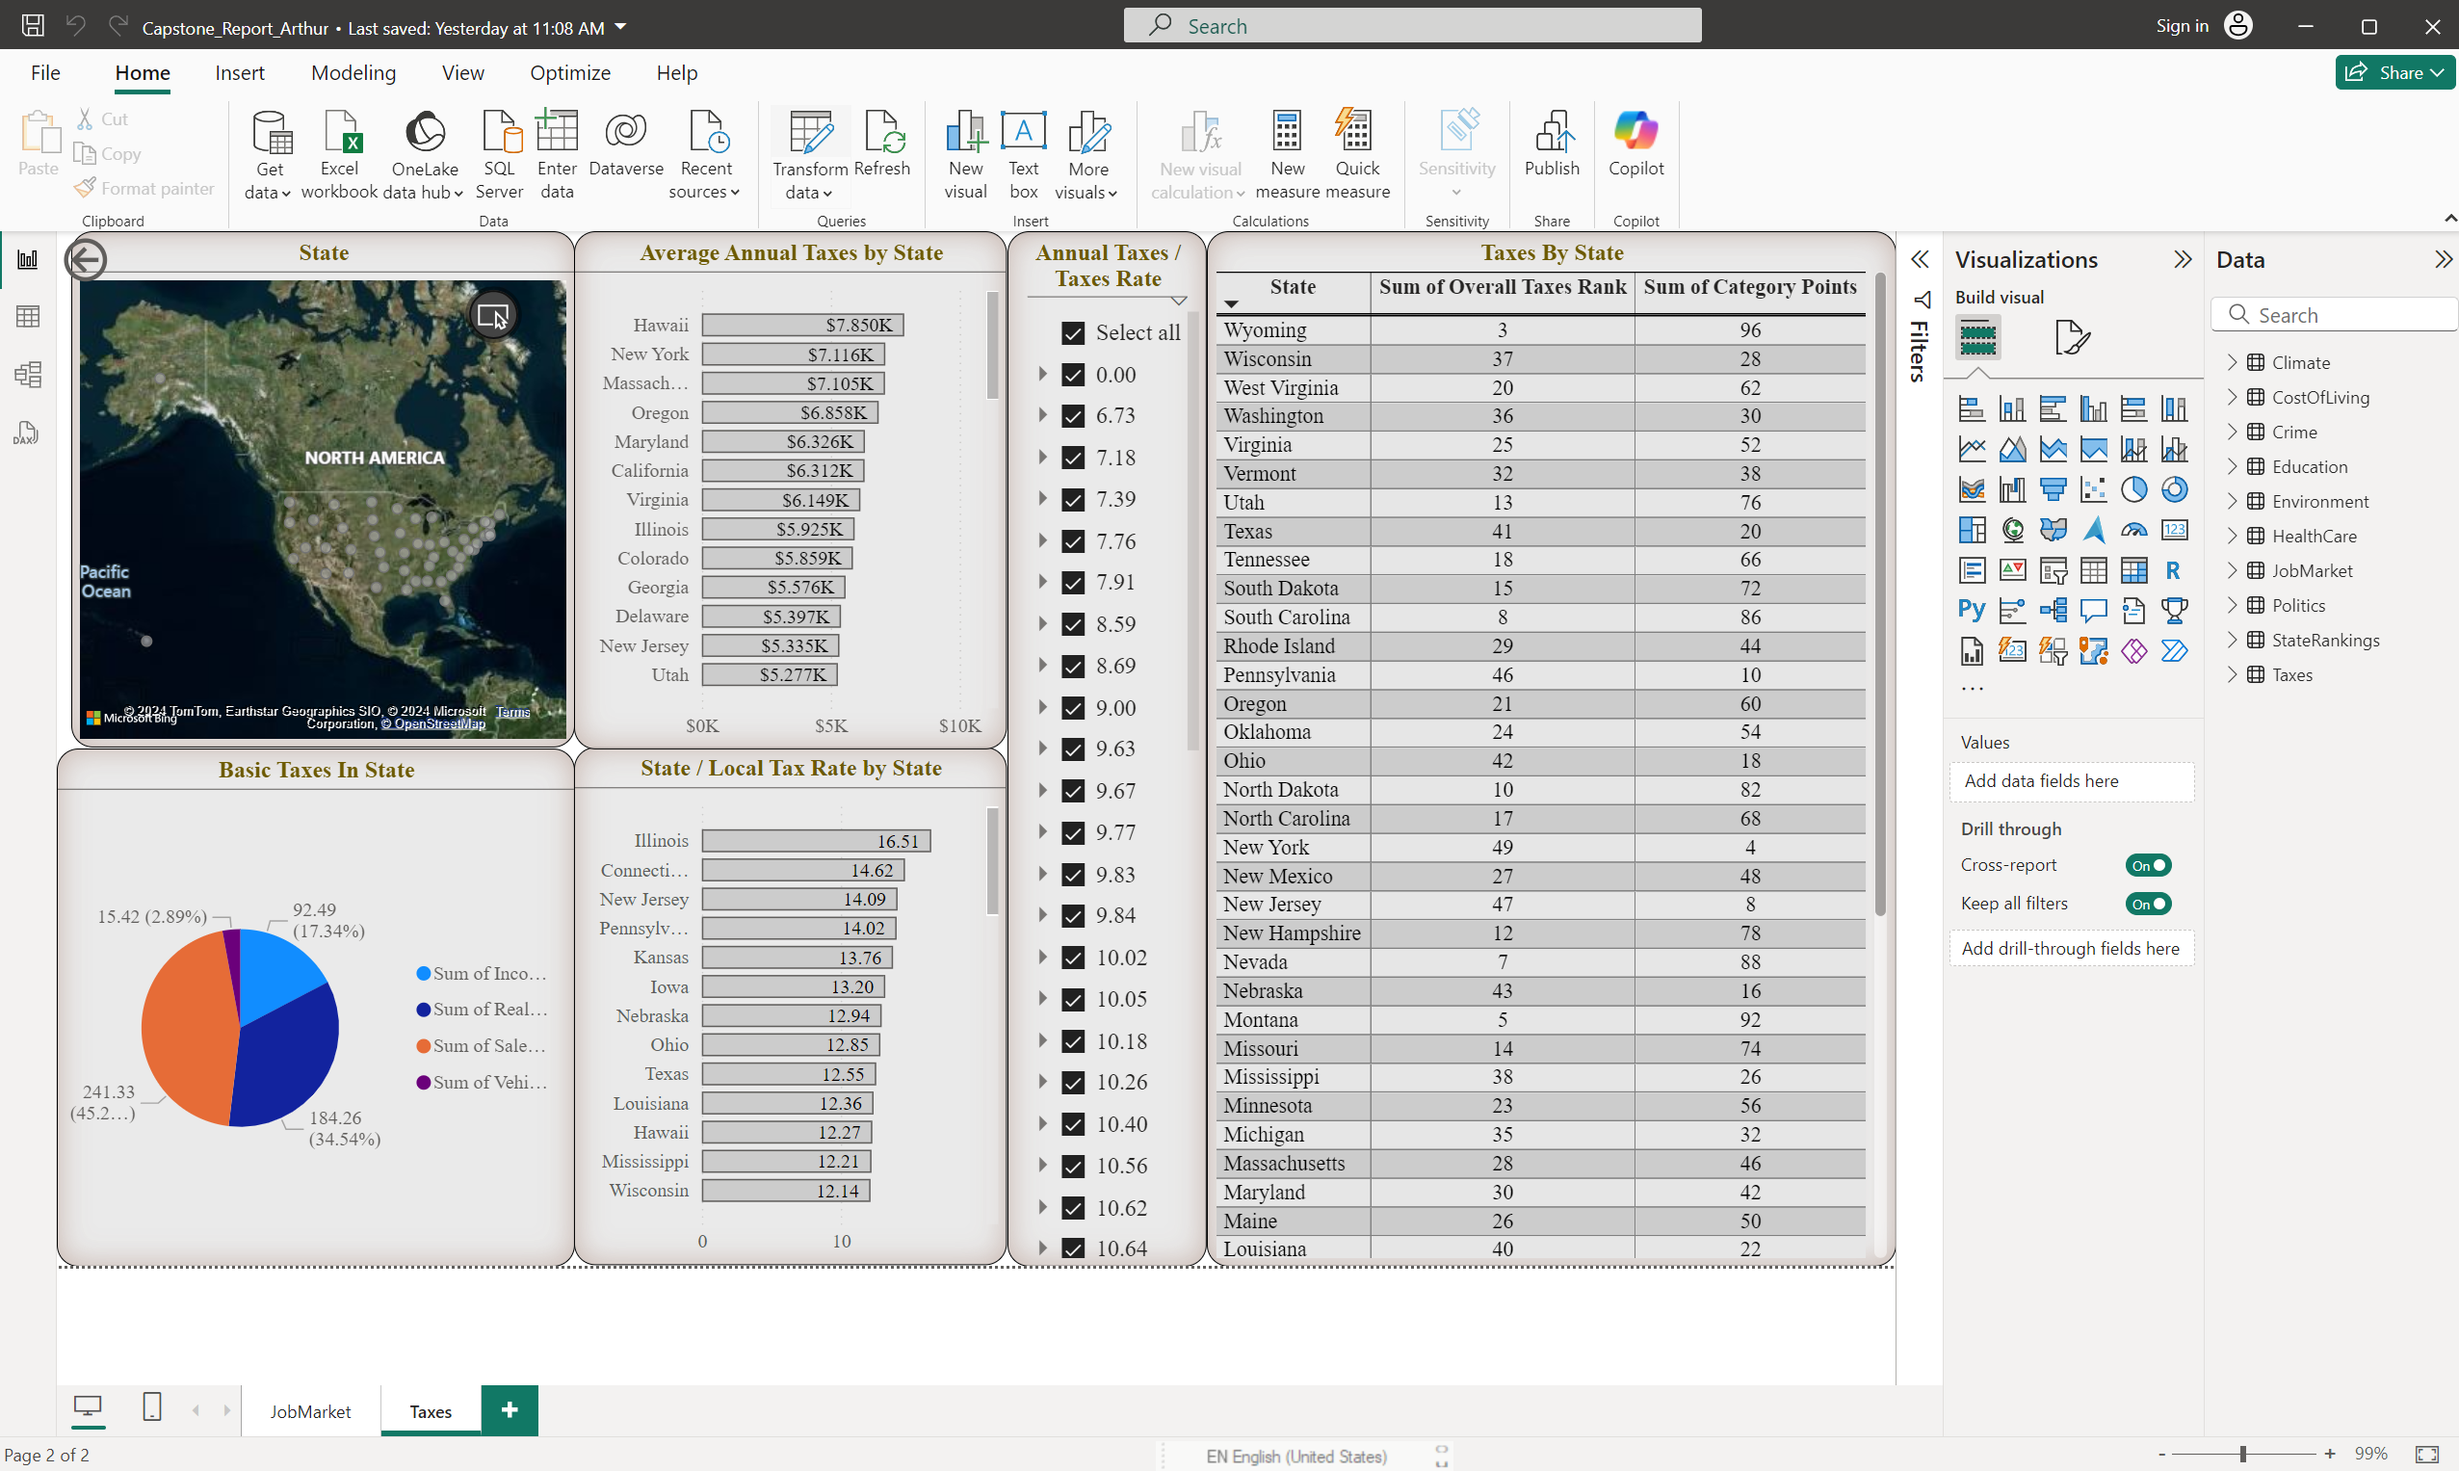
Power BI Taxes

Slide 27

Summary
In summary of the Capstone project:
We gathered and scraped date;
Aggregated it in Excel Spreadsheets;
Modified and organized the data in SQL Server;
Created interactive visualization in Powe BI.

